Slide 2
Announcements
Pwn2Play sign-ups (4 DAYS LEFT!)
Next week is last session of the year (I’m not here :( )

Slide 3
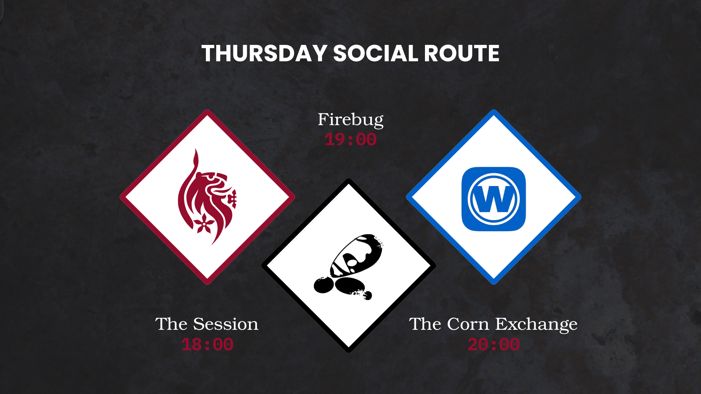

Slide 4

Blue Team CTFs

Slide 5
What challenges are there?
Most CTF heavily focus on Red Teaming, as that covers Pwn, Crypto, Web (the fun stuff), but there are a few Blue Team challenges too. These Typically include:
Log Analysis
Network Traffic Analysis
Malware Analysis
Active defence (thought usually in Red Vs Blue)
So basically a lot of Forensic analysis challenges and some Malware too :D

Slide 6
Forensics
As stated before, most of the blue team challenges you’ll be doing are some or of forensics, which entails going through so much information or data trying to find some clues.
This data can be in the form of .log files, .pcap, .mjpeg (which is motion videos, video but not video) and others. Each of these have tools which allow you to view and digest the data easier.
These can be a system monitor, Wireshark or linux command line tools.

Slide 7



Now you may be asking ‘Josh didn't Amara already give a Forensics talk?’

Slide 8




Yes (Well done).
And i won’t be going over it again cause i’m lazy, so use her slides from the github for tools :D

Slide 9

Walkthrough
Instead i’m going to go through a TryHackMe for a forensics challenge to explain the logic and some ways to think about them, so you have some idea where to start.
Of course this won’t work for everyone of them as every challenge is different, but practice makes perfect.

Slide 10


So Lettuce Begin
The Box I’m going to do a crash course on is Web Attack Forensics.
This is a challenge from last years Advent of Cyber, so is fairly new and has a medium difficulty so has a good balance. (And i won’t embarrass myself)
This is the link: https://tryhackme.com/room/webattackforensics-aoc2025-b4t7c1d5f8

Slide 11
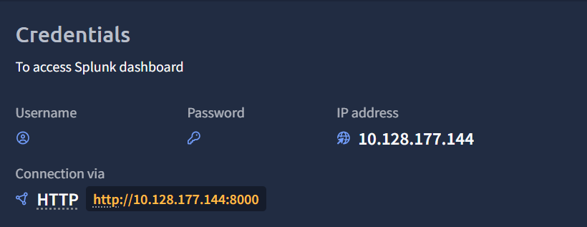
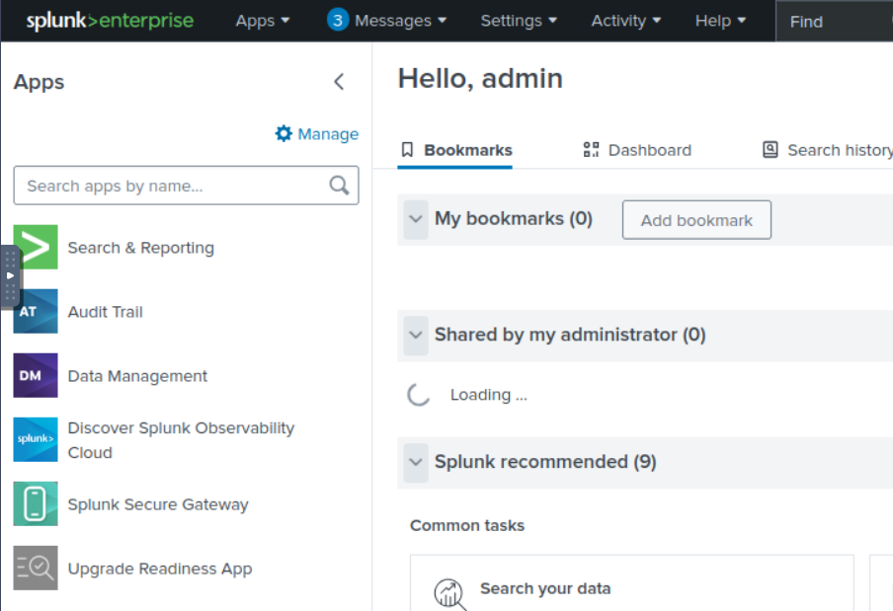
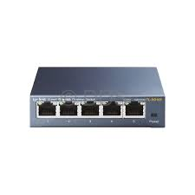
Firstly
After starting the box we can then connect to a website at the IP address. this website is called Splunk and is the main area for the company
not really a lot to explain here so here's a network switch, size doesn't matter so he’s a 5 port O.o
ANYWAYS

Slide 12
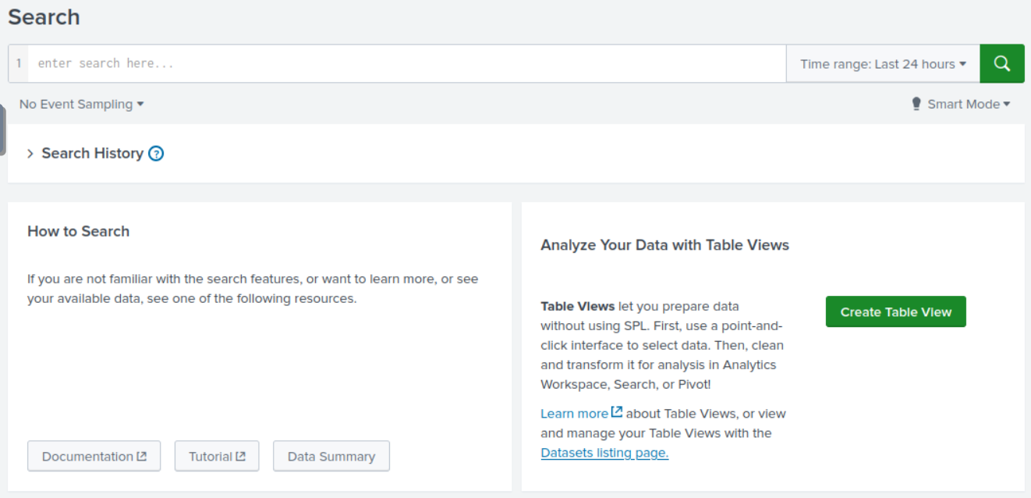
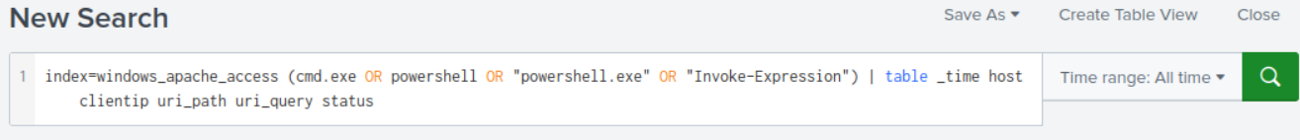
Next
Then going through the website you can find a search menu, allowing us to find what has happened in terms of programs and executables
using the command below we can filter for the important things which are cmd.exe, powershell.exe and powershell, as these are what allow you to run things
The magic command is:
index=windows_apache_access (cmd.exe OR powershell OR "powershell.exe" OR "Invoke-Expression") | table _time host clientip uri_path uri_query status

Slide 13
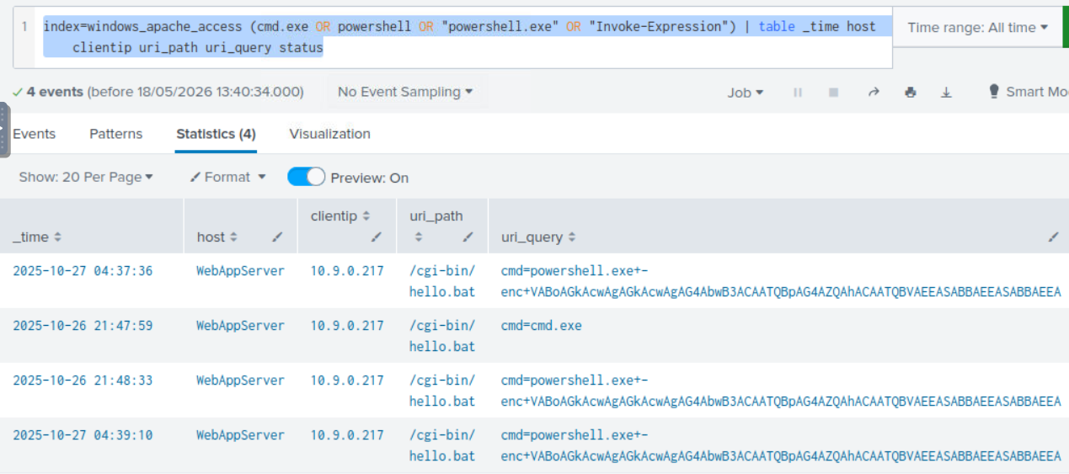
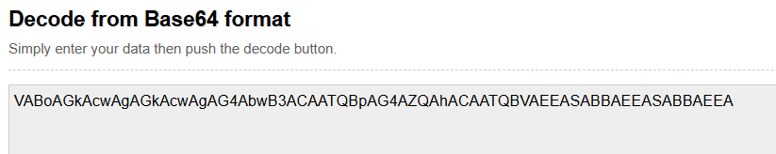
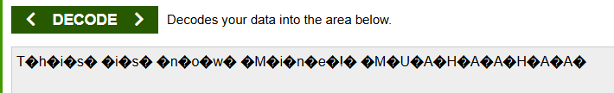
something :)
After searching with the command we can see that the same uni query has been made 3 times, this being ‘cmd=powershell.exe+-enc+VABoAGkAcwAgAGkAcwAgAG4AbwB3ACAATQBpAG4AZQAhACAATQBVAEEASABBAEEASABBAEE
This can be put in a Base64 calc to get the message shown
This actually turns out to be nothing but it taunting us as seen in the picture so we move forward

Slide 14
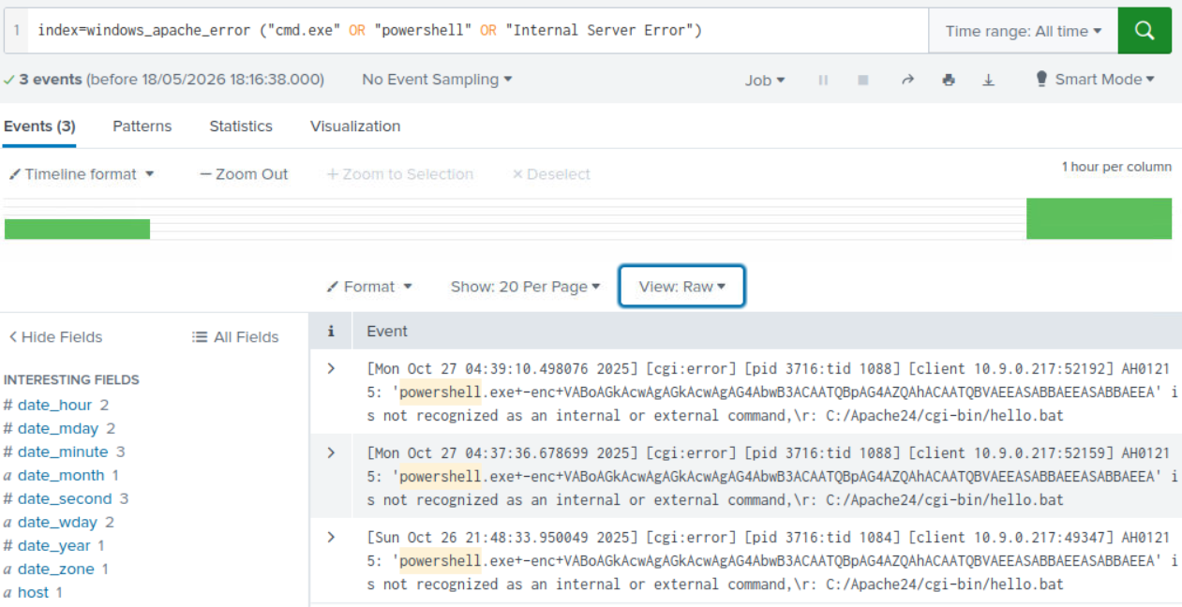
Yet another command
the next thing to do is to check on the server side if anything errored. this will show us what the attacker tried to run and if it managed to go anywhere.
I checked it with this command:
index=windows_apache_error ("cmd.exe" OR "powershell" OR "Internal Server Error")
which is used to check for errors that were caused
however this sadly didn’t lead anywhere useful

Slide 15
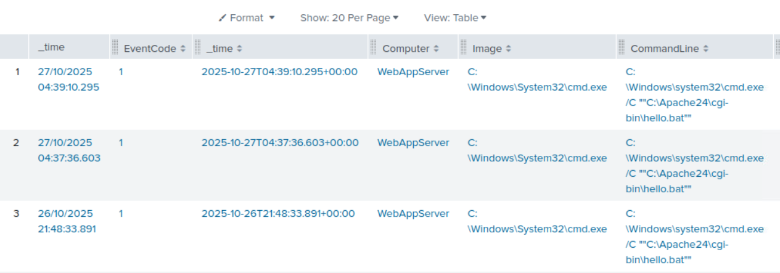
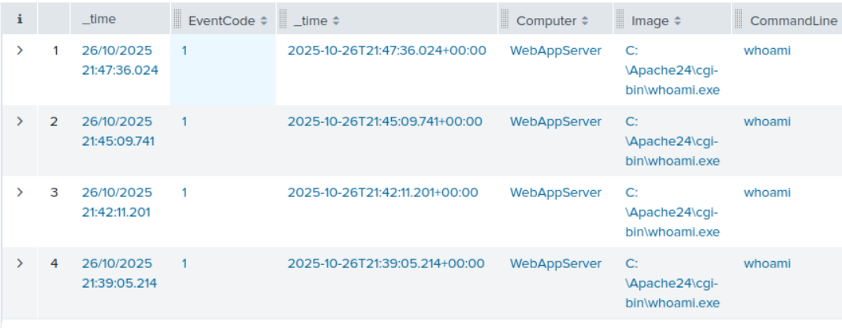
following the attacker
The best route now as we’ve struck out twice is to try and follow what the attacker has done.
this command shows the execution process so we can see what has been done:
index=windows_sysmon ParentImage=”*httpd.exe”
after we can also run a command that searches for specific commands, like ‘whoami’ which is a common one done by attackers to get info about the system
this command is :
index=windows_sysmon *cmd.exe* *whoami*”

Slide 16
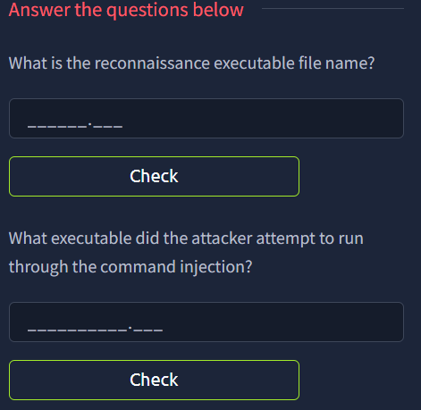
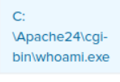

Finally the answer
So thanks to the last command, we now have all the information. For the first one, the attacker tried to be sneaky and name the file ‘whoami.exe’ so you’d look past it, and as it’s not located in the system32 folder we know that.
For the second part, we can go back to the first step where the attacker left the taunting message in Base64, and as it shows us what created that file we know it is ‘powershell.exe’

Slide 17

Summary
That was a very crude and quick explanations of one example of how these challenges can go, but they can really vary. The man thing is to try and say focused and shut out the noise. Gather everything you can that feels important, and then slim it down from there. There are also many tools out there to help, as mentioned in the Forensics talk :)
Again though, the best way with these, sadly like all challenges, is just practice. The more you do the better you get

Slide 18
Practical
Easy:
https://tryhackme.com/room/introdigitalforensics
Medium:
https://tryhackme.com/room/registry-forensics-aoc2025-h6k9j2l5p8
Hard:
https://tryhackme.com/room/forensics
If you get very stuck, google some walkthroughs and follow along with them, they can help you think in different ways than usual.

Slide 19

That’s all from me

